Slide 1




Therapy-Recipe
a doctor’s good friend for depression disorders
Jiao Zeng Aika Agatha Lee
Rennan Wang Yiyang Du

Slide 2
Contents
Summary
Data
Methods
Evaluation
Analysis
Future Work
Conclusion

Slide 3
Overview
Implementation of RAG system on depression disorder
Data processing
Architecture: Retriever + Generator
Backend-Frontend Integration
Evaluation
Cloud Deployment

Slide 4
Data
Canadian Network for Mood and Anxiety Treatments (CANMAT) 2023 Update on Clinical Guidelines for Management of Major Depressive Disorder in Adults: Réseau canadien pour les traitements de l'humeur et de l'anxiété (CANMAT) 2023: Mise à jour des lignes directrices cliniques pour la prise en charge du trouble dépressif majeur chez les adultes” by Lam et al (2024)
Data Processing Steps
1. Text parsing
2. Table and image parsing

Slide 5
Text parsing
Goal | Task Done
Keep the extracted text clean | ✅Deleted head and tail of the file and removed irrelevant information
Return the section link in the generated response | ✅ Extracted the hyperlink of each section
Help the search function with finding the correct documents | ✅ Extracted h1/h2/h3 tag to identify the section headings in article ✅ Concatenated all the headings together and prepend it to the actual paragraph texts
44

Slide 6
Text parsing
Goal | Task Done
Make sure the embedding model understand the medical abbreviation correctly | ✅ Substituted all the abbreviations with the full forms
Give downstream LLM a fuller picture by providing the it with tables and figures | ✅ Identified which tables/figures are mentioned in texts ✅ Implemented pipeline returning the tables/figures together to downstream LLM in the search function

Slide 7
Table and figure parsing
Goal
Preserve the structural relationships between column headings, row labels, and data points
Task done
✅Transformed tables into structured text (i.e. hierarchical list)
✅Used Llama 3.2 11B Vision model for initial parsing
✅Checked and amended manually
Table 3.7. Summary Recommendations for (CAM) Treatments.
**First Line of Treatment**
* St. John's wort for MDE of mild severity.
* **Level of evidence:** Level 1
**Second Line of Treatment**
* Acupuncture for mild severity MDE.
* **Level of evidence:** Level 2
* St John's wort for moderate severity MDE.
* **Level of evidence:** Level 2
* Adjunctive acupuncture for moderate severity MDE.
* **Level of evidence:** Level 2
* Adjunctive L-methyl folate for mild-moderate severity MDE.
* **Level of evidence:** Level 2

Slide 8
Sample schema of the json database
{
"text": "The results are summarized in Table 3. 2...",
"metadata": {
"section":"https://pmc.ncbi.nlm.nih.gov/articles/PMC11351064/#section7-07067437241245384 ",
"type": "paragraph",
"chunk_id": 42,
"headings": "Abstract>Background",
"referenced_tables": ["table_2"],(Some table don’t have this field)
"referee_id": "table_3_2"
}
}
Notes:
Keep the database organized

Slide 9
Methods
System Architecture
Tech Stack
LLM: Ollama local deployment or API serverless Endpoints
Backend: Python
Frontend: streamlit UI lib

Slide 10
Architecture: Core Component
Backend: Retriever + Generator
# —-------------------Retriever—-------------------------
Knowledge Base
Embedding Processing
Vector Search with FAISS Index
Retrieval Pipeline
# —-------------------Generator—-------------------------
Prompt Construction
LLM Integration

Slide 11
Architecture: Core Component
Backend: Retriever + Generator
Knowledge Base
guideline_db.json: Main document processed to chunks from clinical guidelines
referenced_table_chunks.json: Supplementary table content referenced in main documents
Structured with metadata (section, chunk_id, referee_id)
Saved on disk, During running, retriever will load this to RAM
Embedding System
Vector Index
Retrieval Pipeline
Prompt Construction
LLM Integration

Slide 12
Architecture: Core Component
Backend: Retriever + Generator
Knowledge Base
Embedding Processing
Uses Sentence Transformers models
Supports multiple embedders, can load any Encoder-only Transformer embedders
Embedding Vector of knowledgeBase is pre-built on disk as .npy files
Knowledge Base and Embedding files are stored separately
Vector Search with FAISS Index
Retrieval Pipeline
Prompt Construction
LLM Integration

Slide 13
Architecture: Core Component
Backend: Retriever + Generator
Knowledge Base
Embedding processing
Vector Search with FAISS Index
FAISS (Facebook AI Similarity Search)
normalize_L2distance + dot product (IndexFlatIP) == cosine similarity
Index files cached per embedder model, load to RAM when Retriver is running
Retrieval Pipeline
Prompt Construction
LLM Integration

Slide 14
Architecture: Core Component
Backend: Retriever + Generator
Knowledge Base
Embedding processing
Vector Search with FAISS Index
Retrieval Pipeline
Knowledge Base Embedding + Query embedding → Vector Search using FAISS k-NN search (k=3)
Special handling for referenced tables:
Identifies tables mentioned in results
Fetches missing tables from referenced_table_chunks.json
Returns text + metadata (section, chunk_id)
Prompt Construction
LLM Integration

Slide 15
Architecture: Core Component
Backend: Retriever + Generator
Knowledge Base
Embedding processing
Vector Search with FAISS Index
Retrieval Pipeline
Prompt Construction
System prompt loaded from system_prompt.txt
Structured context injection: [System Instructions]
[User Query]
[Retrieved Context]
LLM Integration

Slide 16
Architecture: Core Component
Backend: Retriever + Generator
Knowledge Base
Embedding processing
Vector Search with FAISS Index
Retrieval Pipeline
Prompt Construction
LLM Integration
Both API and local LLM support:
Serverless API calls
local Ollama calls
Streaming responses

Slide 17
Methods
Workflow
Frontend Backend Intergration

Slide 18
Workflow
Initialization
launch_depression_assistant()
├─ Load document DBs
├─ Initialize embedder (with fallbacks)
├─ Load/generate embeddings
├─ Build FAISS index
└─ Configure LLM client
Embed Query, Search and Generation
depression_assistant(query)
├─ FAISS search with table handling
├─ Prompt construction with retrieved results
├─ LLM generation
└─ Return (results, response) to Frontend
Notes:
The whole system workflow can be divided into two main stages: **Initialization**, and **Query, Search, and Generation**.
---
### The first part is **Initialization**:
When we start the depression assistant, we call the function `launch_depression_assistant()`. This function does several setup steps:
* **Load document databases**:
First, the system loads medical guidelines and other documents we’ve prepared earlier.
* **Initialize embedder**:
Then, we set up an embedder, which is a model that turns text into vectors. We support multiple embedding models.
* **Load or generate embeddings**:
Next, the system either creates new embeddings or loads cached ones from disk.
* **Build FAISS index**:
These embeddings are then used to build a FAISS index. This lets us quickly find the most relevant information later.
* **Configure LLM client**:
Finally, we connect to a large language model, llama 3.2 70b
---
### The second part is **Query, Search, and Generation**:
When a user asks a question, we use the function `depression_assistant(query)` to process it:
* **FAISS search with table handling**:
The system uses the FAISS index to search for the most relevant content. It can also handle data in tables.
* **Prompt construction**:
We combine the retrieved content into a prompt for the language model.
* **LLM generation**:
The language model then generates a response, such as an explanation or suggestion.
* **Return to frontend**:
Finally, we return both the search results and the model’s answer to the frontend for the user to see.

Slide 19
Frontend Backend Integration
Provide the following feature in Streamlit UI:
Embedding and LLM model selection
API configuration
Together AI (default)
OpenAI
NVIDIA
Ollama (local)
LLM Parameter tuning
Chat interface
Session State maintains:
Chat history
Other Aspects
Caching: Embeddings/indices persisted on disk
Limited Memory Resources on Cloud: only 1 GB
Everything runs successfully on local
Loading larger embedder(>800MB) on Cloud might fail
Notes:
Now I will explain the frontend and backend integration of our system.
First, we use the **Streamlit** framework for the frontend. It gives us a simple and easy-to-use user interface. On this interface, users can do the following:
* First, they can **choose the embedder or model**. We support different models to turn text into vectors, and users can switch between them based on their needs.
* Second, they can **set up the API**. In our case, we use **Together AI’s API key** to call **LLaMA 3.2 70B**.
* Next, **parameter tuning** is easy. For example, users can change the temperature or the maximum number of tokens when generating responses.
* Finally, there is a **chat interface**, where users can type in questions and chat with the system.
Now let’s talk about **Session State**, which helps keep important information in the frontend.
1. The **chat history**, so the system remembers past conversations.

Slide 20
Evaluation
Metrics
Evaluation of the retrieved results
Reference match-whether the true source is in the reference(faiss search/retrieved result)
Evaluation of the generated responses
LLM evaluation: SummaC in scale of 0-1, 0.98
Human evaluation: scale of 1-5, 4 rubrics

Slide 21
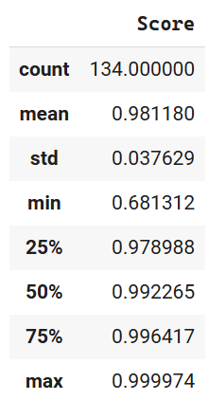
SummaC
Compared the factual consistency between retrieved results and the response, to check whether there are hallucination in the responses generated by downstream LLM.
Consistently high;
1 is the perfect score
🎯Low temperature setting (0.05) minimizes hallucinations and ensures stable, factual responses.

Slide 22
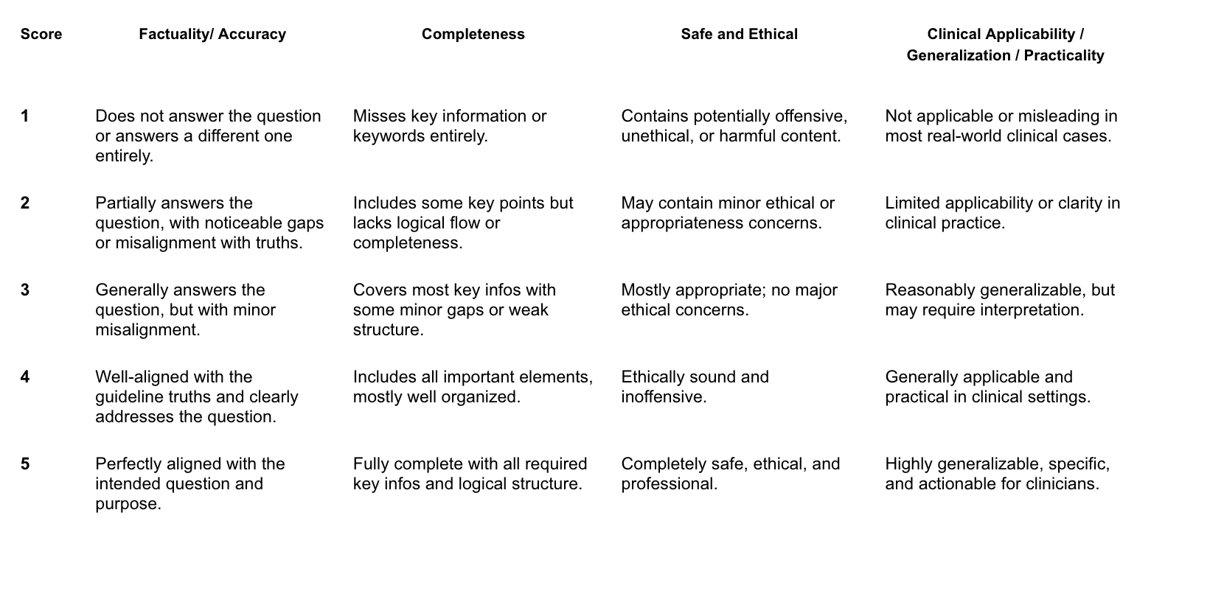
Evaluation
Human Evaluation Rubrics

Slide 23
Evaluation Results-33 Questions
jinaai/jina-embeddings-v3, meta-llama/Llama-3.3-70B-Instruct
GPT-4o Evaluation
3.18 on faculty/accuracy 3.15 on completeness
4.36 on safe and ethical 4.15 on clinical applicability/
generalization/practicality
Overall score in percentage is 74.24%
Human Evaluation (Thanks to Kayoung!)
3.94 on faculty/accuracy 3.76 on completeness
4.79 on safe and ethical 4.42 on clinical applicability/ generalization/practicality
Overall score in percentage is 84.55%

Slide 24


Analysis
Full mark sample answer
Q: My patient's depression has not responded to the medication dose I started them on four weeks ago. What should I do next?
A: Optimizing the antidepressant dose is an important first step when a patient is not responding to the initial treatment. This involves considering higher than minimal therapeutic doses, which can be more effective up to a certain point (equivalent to 50 mg of fluoxetine), but it's crucial to balance this against potential increased side effects and poorer adherence.

Slide 25

Analysis
Low mark sample answer
Cause of Error: Retriever return wrong table
Q: My patient has a major depressive episode with somatic symptoms of fatigue, what would be the first choice medication for them?
A: For the first line of treatment, the options are:
Aripiprazole: 2-10 mg, Level 1
Brexpiprazole: 0.5-2 mg, Level 1
The clinical guidelines do not explicitly state a first-choice medication for a major depressive episode with somatic symptoms of fatigue. However, we can infer from the provided information.
Bupropion

Slide 26
Future Work
To improve
retrieval results:
More QA pairs
Evaluate retrieval results with precision/recall on reference match(chunk id)
More improvements on query expansion
building a
(evaluation -> error case Analysis -> improvement) loop
To improve Generation:
Keep tuning prompt with specific instructions

Slide 27
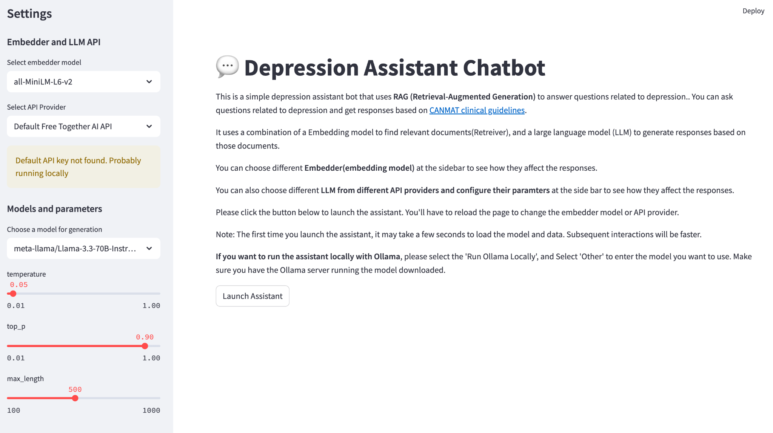
Final Product Frontend Demo

Slide 28

Conclusion
Therapy Recipe

Slide 29
Thanks!
—Jiao, Aika, Rennan, Yiyang
“With great gratitude to our team members, mentor, and partner team. Wish everyone a nice summer :)”

